Slide 1
Software QA and Testing with Automation using Selenium WebDriver Course 1, Class 3 Deck 4 IDE Lists and Buttons
Instructor
David F Wagoner
PMP, CSQE, CMQ/OE
Copyright 2015 Montgomery College, David F Wagoner

Slide 2
Course Objectives
Learn how to:
Use Selenium WebDriver to develop automated scripts and suites using different browsers
Use Python to code the Selenese commands for scripts
Structure scripts into suites
Develop a test suite to exercise a web commerce site

Slide 3
IDE Lists and Button Groups
These are similar to small arrays of data, each value stored separately for a group of list items or group of related buttons
IDE allows selection by using the value desired or an index
Indices start at zero, so the second item is index number 1
You SELECT a list item and CLICK a radio button

Slide 4
IDE Lists and Button Groups
To address a list and select an entry:
Select
name=<field name> label=<literal value>, or
name=<field name> index=<integer>
To address a group of buttons
Click
name=<field name> value=<literal value>, or
name=<field name> index=<integer>
In the above, the value parameter is blank

Slide 5
Brief IDE Lab
Open http://newtours.demoaut.com/ and create a new script
Login to site, you’ll be on reservations page
Enter the scripting provided on screen

Slide 6
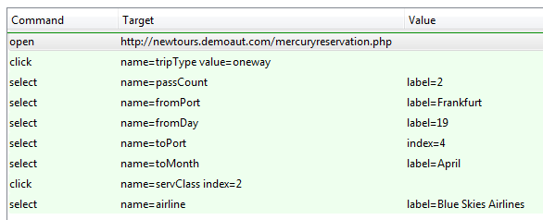
Lab

